Slide 1
Exploratory Data Analysis Of Predictive Analytics And Recommendation Systems In Banking

Slide 2
agenda
INTRODUCTION 3
Data Collection and Preparation 4
Data Visualization Techniques 5
Statistical Analysis 6
Practical Application of EDA in My Project 11

Slide 3

Introduction to EDA

Slide 4
Importance of EDA
Identifying Data Issues
It aids in identifying potential data issues such as missing values, outliers, and data inconsistencies that need to be addressed.
Understanding Data Trends:
EDA helps in understanding the underlying patterns and trends in the dataset, which can give insights into how variables are related.

Slide 5
Key Concepts in EDA
Data Cleaning:
This process involves removing or correcting inaccurate records from a dataset which is crucial to ensure the quality of data analysis.
Data Transformation
Data transformation involves converting data into a suitable format or structure for analysis, which may include normalization, scaling, or encoding.
Data Visualization
Creating visual representations of data helps in summarizing and presenting the data distributions and relationships in an easily interpretable form.

Slide 6
Data Collection and Preparation

Slide 7
Collecting Data
Sources of Data
Identifying various sources such as surveys, databases, APIs, and web scraping that are used to gather relevant data for analysis. Here i have used faker dataset from python.
Data Collection Methods
Exploring different techniques like manual entry, automated tools, and electronic data interchange for collecting data efficiently.

Slide 8
Preparing Data
Handling Missing Values
Techniques for addressing missing data, including imputation, deletion, or using statistical models to ensure dataset completeness.
Data Normalization
The process of scaling data to bring all features into a uniform range, improving model performance and comparability.
Data Integration
Combining data from different sources and ensuring consistency and accuracy, creating a cohesive dataset for analysis.

Slide 9
Data Visualization Techniques

Slide 10
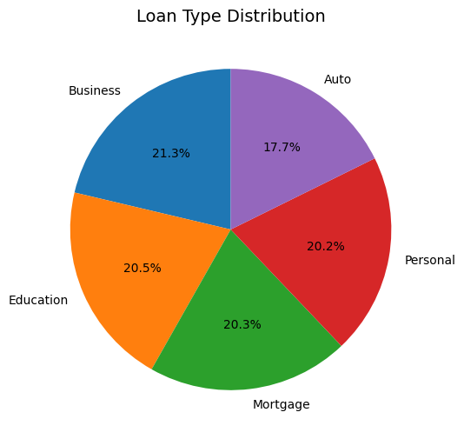
Pie chart
A pie chart is a circular statistical graphic divided into slices to illustrate numerical proportions. It is an effective way to visually represent the relative sizes of data categories.
This pie chart displays the distribution of loan purposes among customers. It shows that the Business are the most common loan type followed by Education,Mortgage, Personal and Auto.

Slide 11
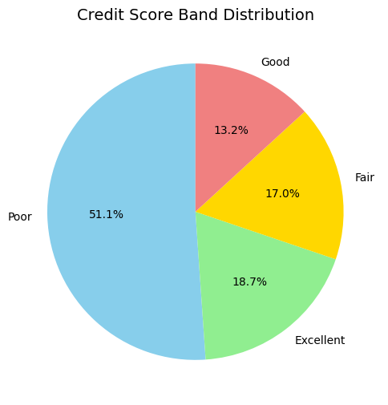
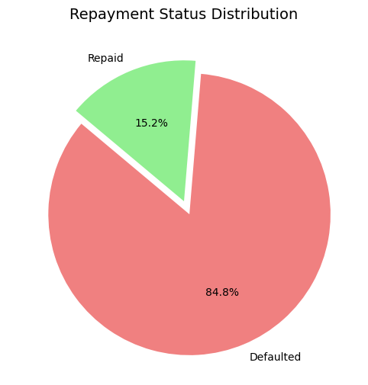
This pie chart displays the distribution of credit score band among customers. It shows that the most of the customers are with poor credit score band than excellent, fair and good.
This pie chart displays the distribution of Repayment status among customers. It shows that the most of the customers are defaulted than repaid.

Slide 12
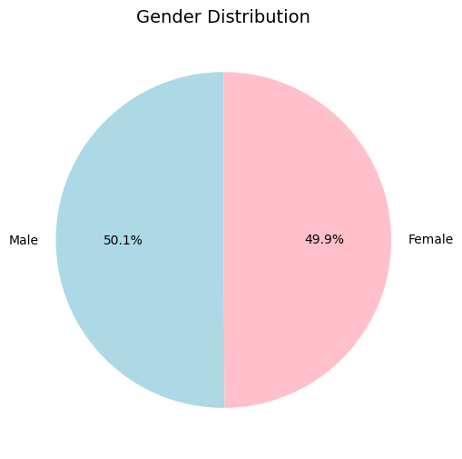
This pie chart displays the distribution of Gender among customers. It shows that the 50.1% customers are male and 49.9% are female.

Slide 13
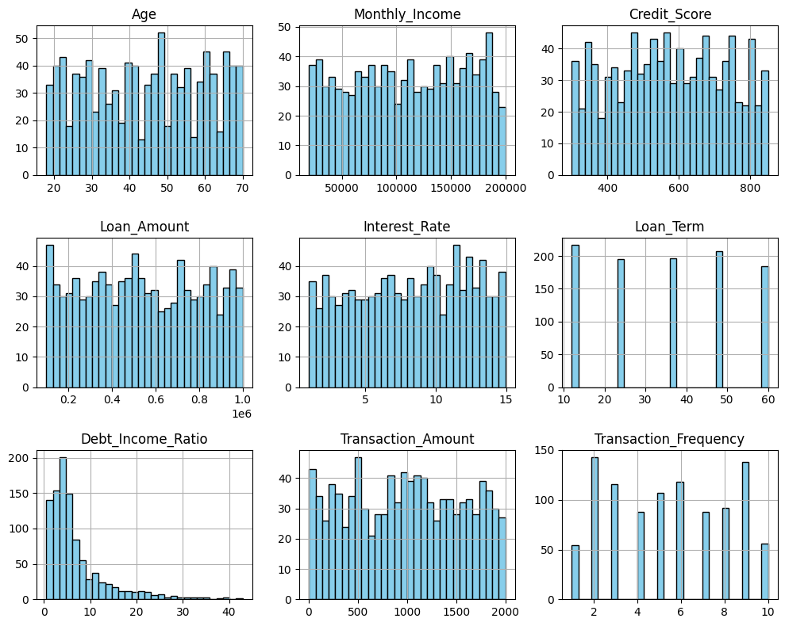
Histogram
A histogram represents the distribution of a single data variable by using bars to show the frequency of data intervals.
The distribution appears relatively uniform, with a slight peak around the 50-year age group.
The income is evenly distributed across the range, with no dominant income group.
A balanced spread of credit scores, with no extreme concentration in any range.

Slide 14
The loan amounts are uniformly distributed with few spikes in certain ranges.
Interest rates appear to be uniformly distributed.
Specific loan terms (e.g., 20, 30, 40, 50, 60 months) dominate, suggesting predefined options in the dataset.
Skewed toward lower ratios, indicating that most customers have manageable debt levels compared to their income.
Transaction amounts show a fairly uniform distribution, with some higher-frequency bins in mid-range values
The frequency of transactions varies, with peaks at certain specific values, possibly indicating common transaction behaviors.

Slide 15
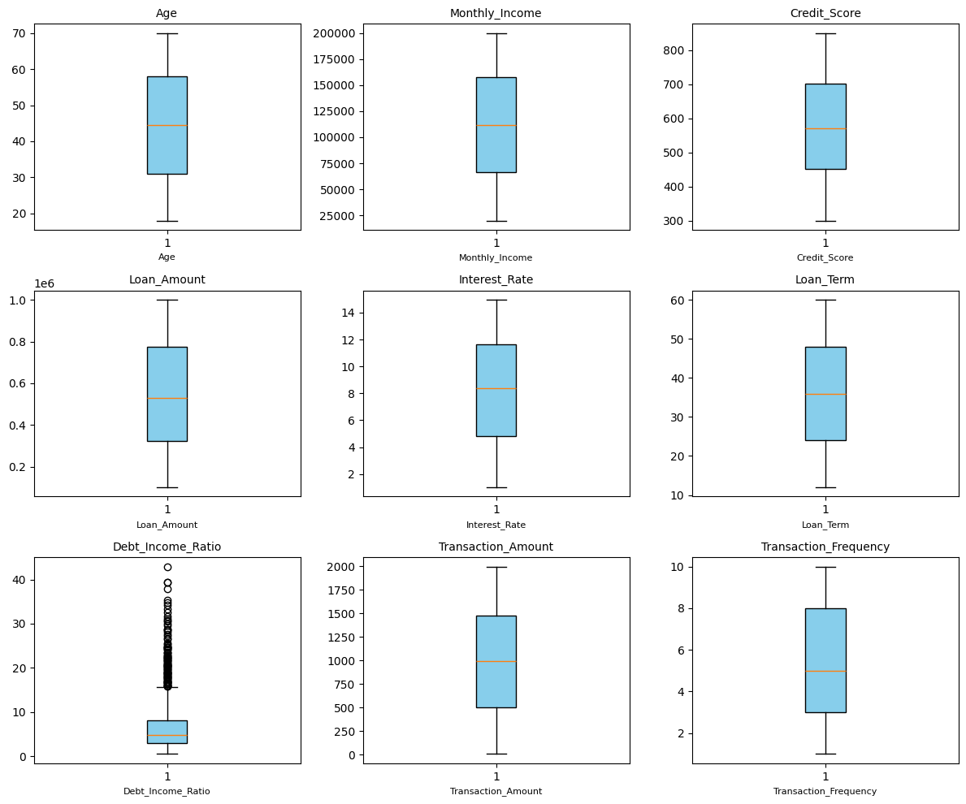
Box plot
A boxplot (also known as a box-and-whisker plot) is a statistical visualization tool used to summarize the distribution of a dataset and identify patterns, variability, and outliers.
The box plots provide a comprehensive overview of the dataset's numeric variables, highlighting their distributions, central tendencies, and outliers. Most variables, such as Age, Monthly Income, Credit Score, Loan Amount, Interest Rate, and Loan Term, exhibit well-distributed values with no significant outliers, indicating consistency in the data. However, the Debt-to-Income Ratio shows noticeable outliers, suggesting a subset of customers with disproportionately high ratios.

Slide 16
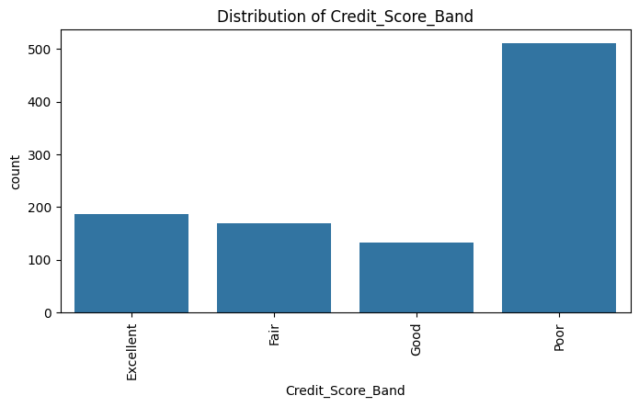
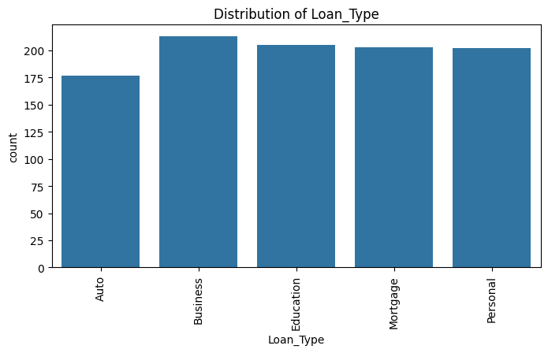
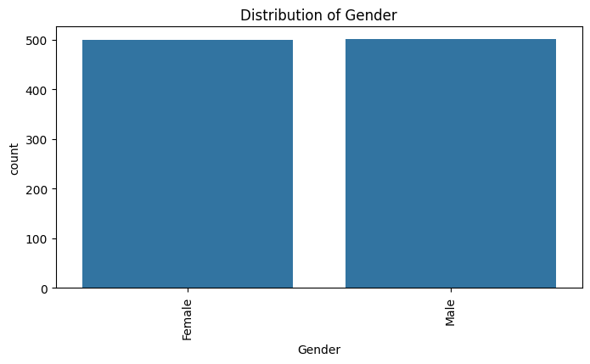
Count plot
A count plot is a visualization that displays the count of observations in each categorical variable. It is a useful way to understand the frequency distribution of categories in your data. Count plots are commonly used in Exploratory Data Analysis (EDA) to compare the number of occurrences of each category in a dataset.

Slide 17
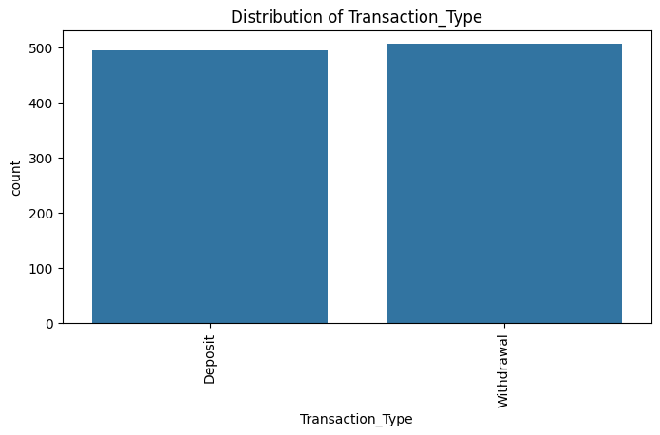
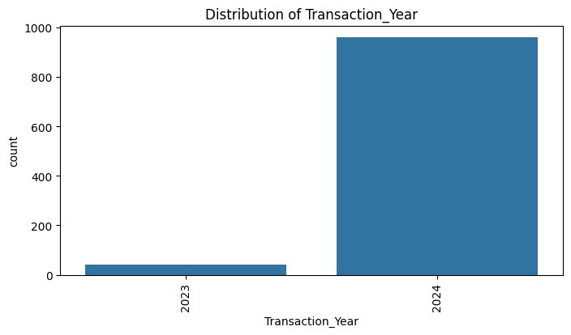
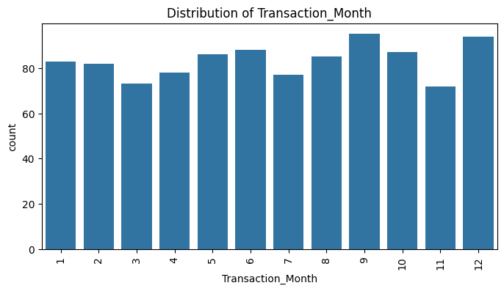

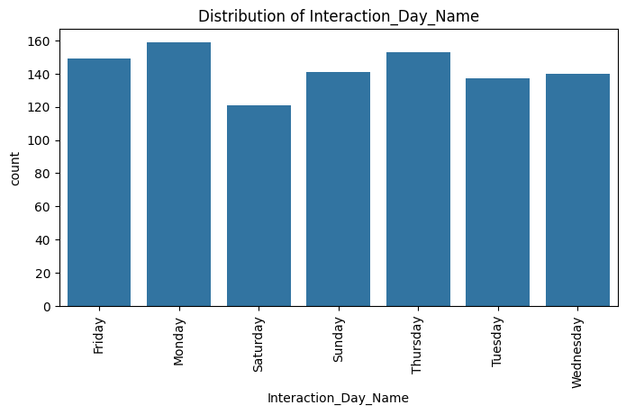
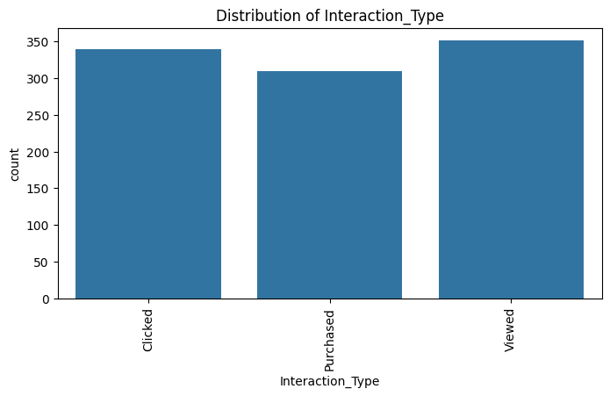

Slide 18
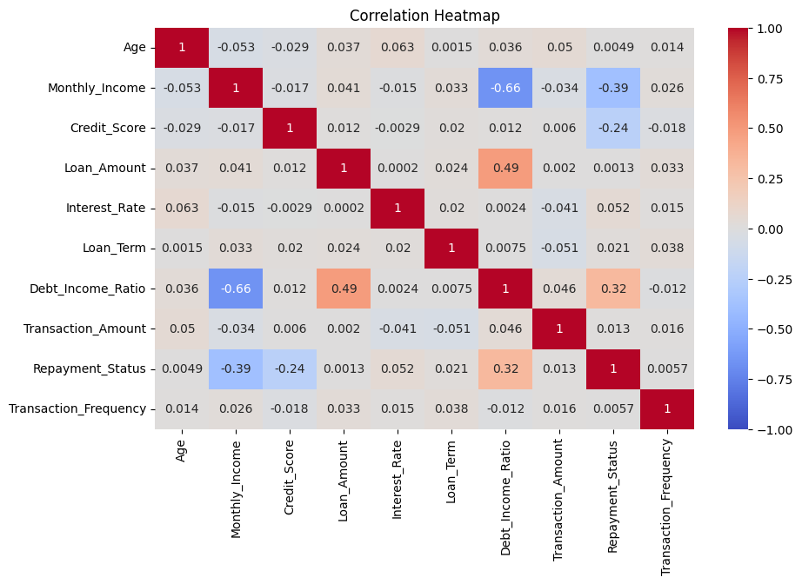
Heat map
A heatmap is a data visualization tool that uses color gradients to represent the intensity or magnitude of data values. It helps to quickly identify patterns, correlations, and outliers within a dataset. Each cell in the heatmap corresponds to a data point, and its color indicates the value, with warmer colors (like red or orange) typically representing higher values and cooler colors (like blue or green) representing lower values.
The heat map displays the relationships between different variables related to loan data. This plot displays that The Monthly Income and Debt Income are strong negative correlations. The Debt Income and Repayment Status are strong positive correlations. The Loan Amount and Debt Income are strong positive correlations.

Slide 19
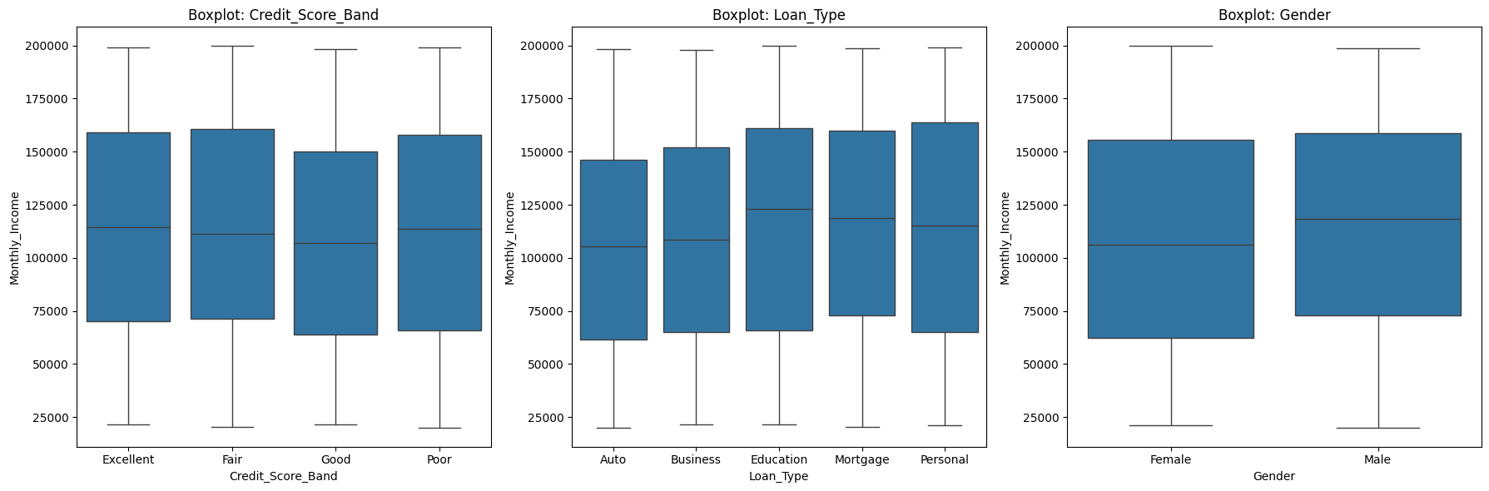
Violin plot
A violin plot is a method of plotting numeric data that combines aspects of a box plot with a density plot. It provides a more detailed overview of the distribution of the data.

Slide 20
Customers with higher credit scores tend to have higher monthly income regardless of gender or loan type.
Customers with higher incomes are more likely to have personal loans.
Gender has minimal impact on monthly income.

Slide 21
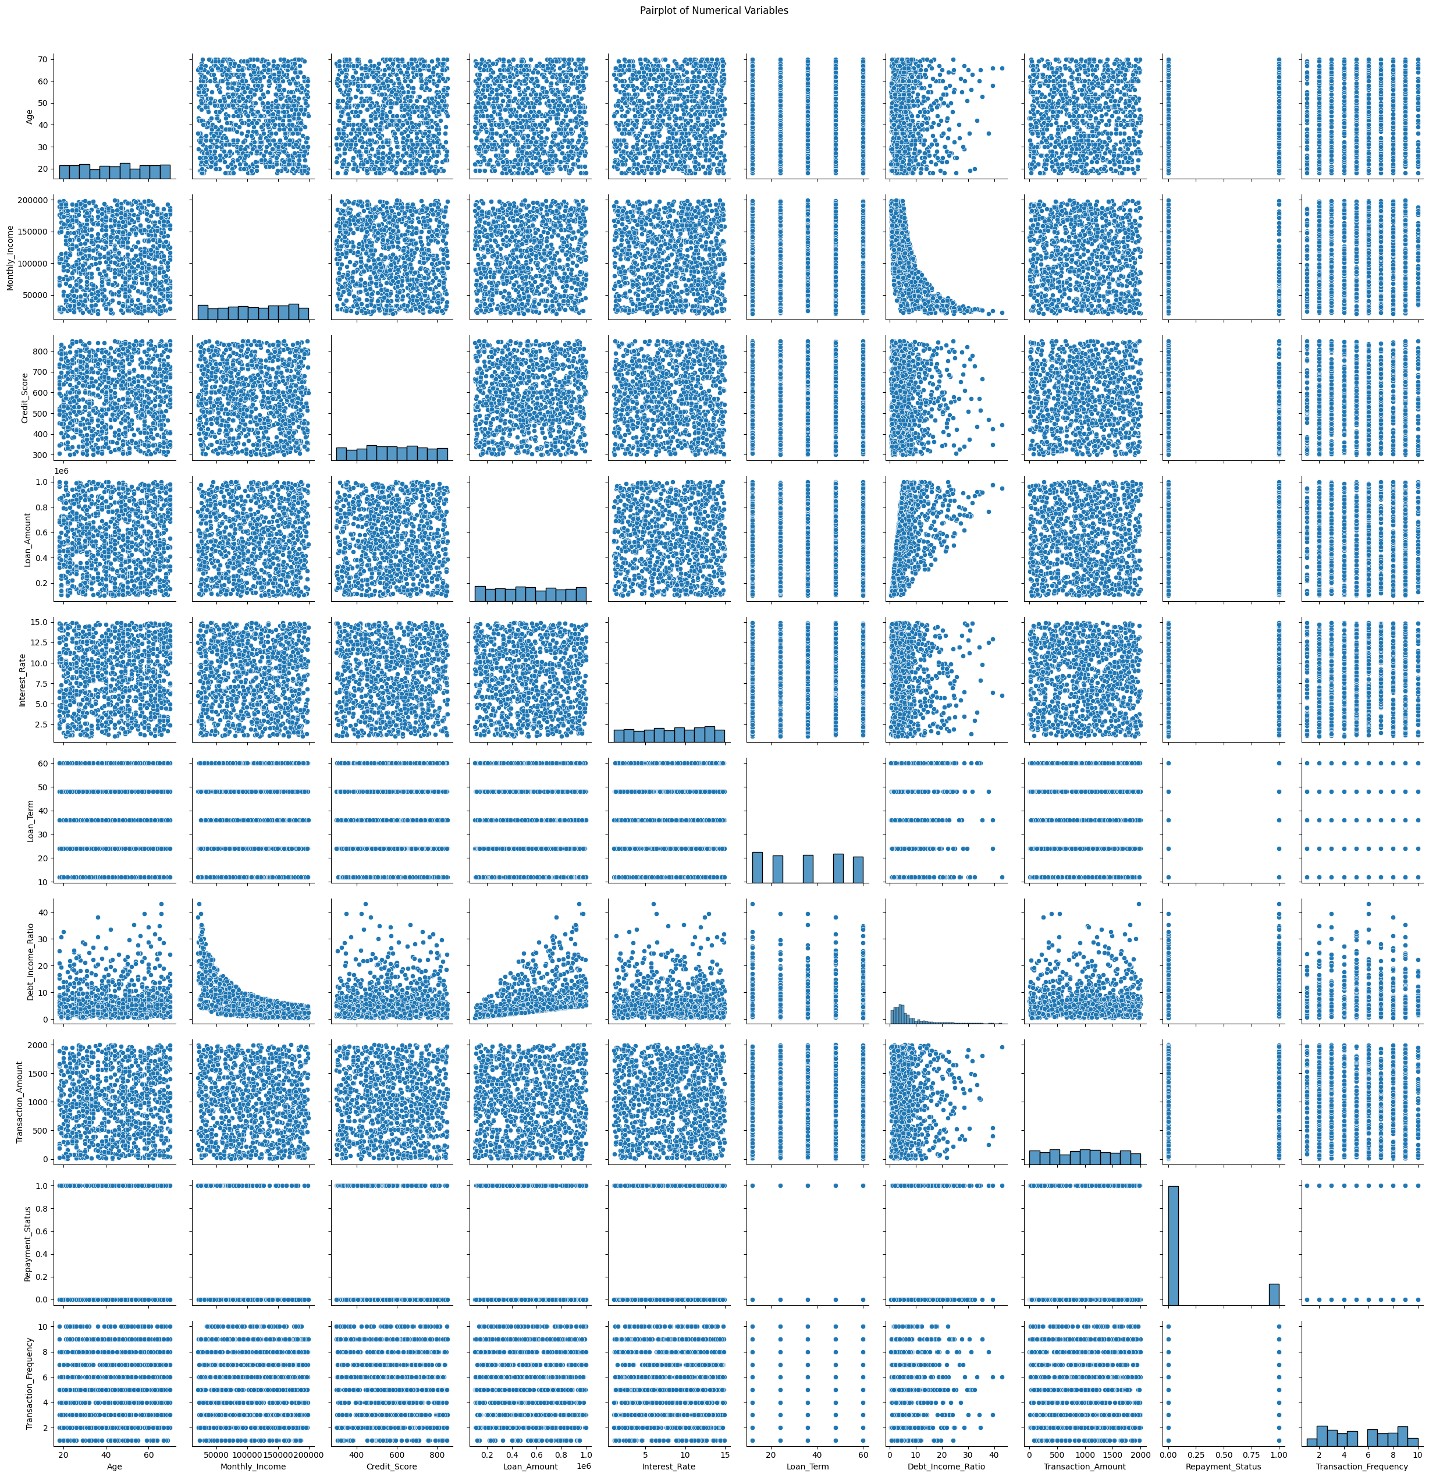
Pair plot
The pair plot visually represents the relationships between multiple numerical variables in the dataset. Each subplot in the pair plot shows the scatter plot or histogram of two variables plotted against each other, while the diagonal subplots display the distribution of each variable individually.

Slide 22
Correlation Identification: The scatter plots reveal correlations between pairs of variables. For instance, there may be a positive correlation between Annual Income and Credit Score, indicating that higher incomes are associated with better credit scores.
Distribution Patterns: The histograms on the diagonal provide insights into the distribution of each variable. They help identify whether the data is normally distributed, skewed, or contains outliers.
Variable Relationships: Scatter plots can show linear or non-linear relationships between variables. For example, the plot might show a relationship between Loan Amount and Debt-to-Income Ratio, indicating that higher loan amounts are associated with higher debt burdens.

Slide 23
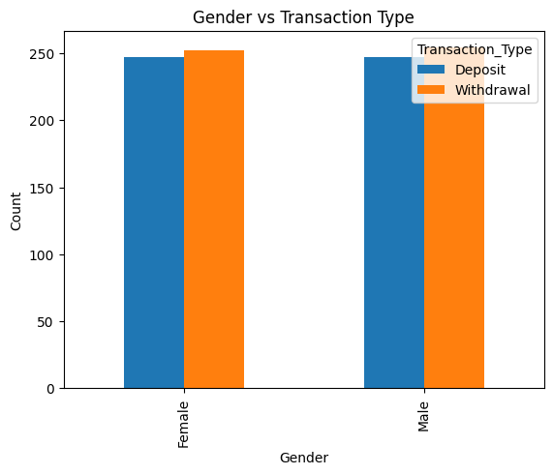
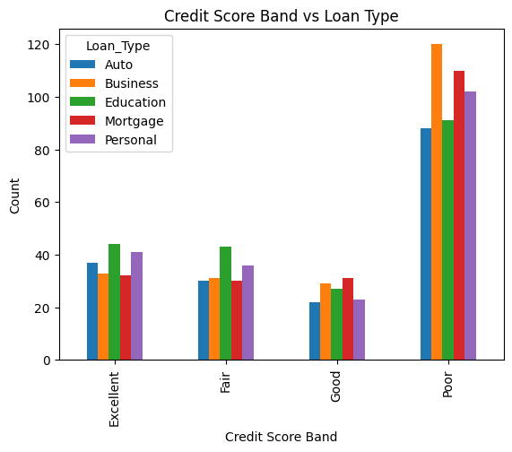
Cross tab and stacked bar chart
A crosstab bar chart visualizes the relationship between two or more categorical variables by displaying their frequency distribution in a bar chart format. This method combines cross-tabulation (crosstab) with bar chart visualization to provide a clear comparison of categories.
A stacked bar chart displays the composition of a whole by stacking multiple bars on top of each other, each representing a different sub-category. The length of each segment indicates its proportion relative to the total. This chart type is useful for comparing the total values across categories and understanding the distribution within each category.

Slide 24
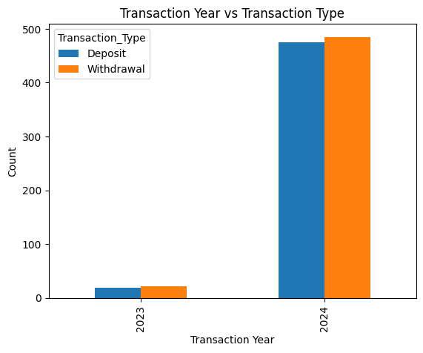
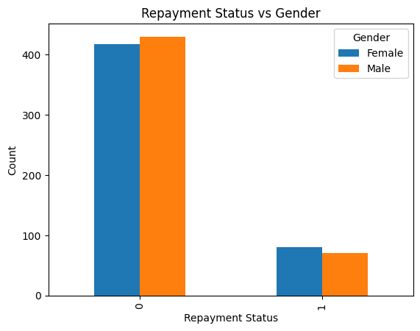

Slide 25
Conclusion
In conclusion, our exploratory data analysis (EDA) has provided valuable insights into the banking domain, particularly in predicting loan defaults, customer segmentation, and product recommendations. We observed distinct patterns in customer behavior, such as a correlation between financial history and loan defaults, and identifiable segments of customers with similar preferences. These findings highlight opportunities for improved customer targeting and personalized product offerings. However, we also identified limitations in the dataset, including missing or inconsistent data in certain variables, which could affect the accuracy of our models. Moving forward, we recommend enhancing the dataset through feature engineering and additional data collection to improve predictive accuracy. Additionally, further investigation into causal relationships and testing different recommendation algorithms would strengthen the outcomes of our predictive models. Overall, this EDA emphasizes the crucial role of data exploration in uncovering actionable insights, driving better decision-making in banking.

Slide 26
thank you

